Slide 1


The Profile
(Google Scholar Citations)
Japura Media
May 2015
Prof Hiran Amarasekera
University of Sri Jayewardenepura

Slide 2
Why scholar profiles?
250 best researchers in Sri Lanka on webometrics.info
University of Kelaniya - 47 researchers
University of Peradeniya – 47 researchers
University of Colombo - 42 researchers
University of Sri Jayewardenepura – 6 researchers
http://www.webometrics.info/en/node/103

Slide 3
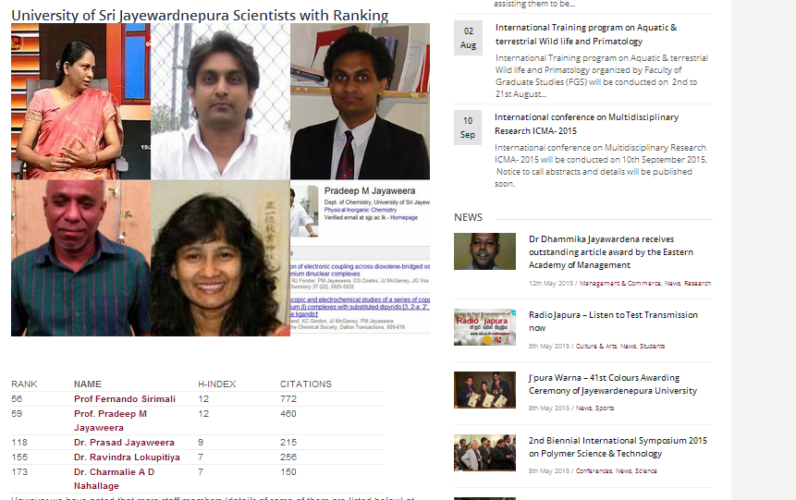
Why scholar profiles?

Slide 4
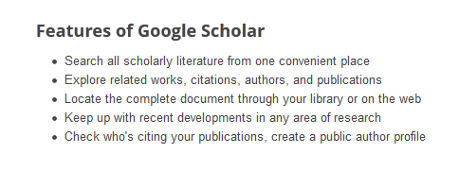
About Google Scholar
Search for scholarly literature (e.g. articles, theses, books, abstracts, etc)
Screenshot of features from: http://scholar.google.com/intl/en/scholar/about.html
Notes:
You can set up a Google Scholar profile to keep a list of all your outputs in one easy to access place as well as using it to keep track of who is citing your publications

Slide 5
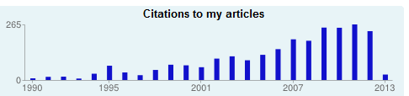
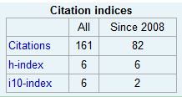
About the Google Scholar Profile
Google Scholar Citations
  Keep track of the citations of your articles
    Who is citing them
    Graph over time
    Metrics
  Private/public
    If public, seen in a Google Scholar search for your name!
Notes:
Within the profile you can see who is citing you articles and view your citations as a graph over time. There are also metrics available: number of citations, H-index and i10 index. And you can choose whether to make your profile public or keep it private (default)

Slide 6
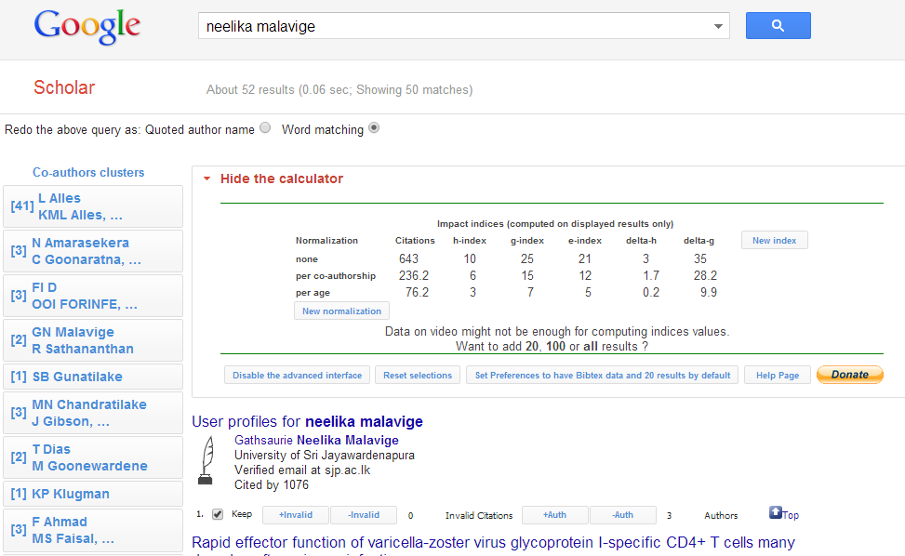
With a public GS profile, when someone searches for you, the link to your profile will appear at the top of the results page.
Notes:
With a public GS profile, when someone searches for you, the link to your profile will appear at the top of the results page.

Slide 7
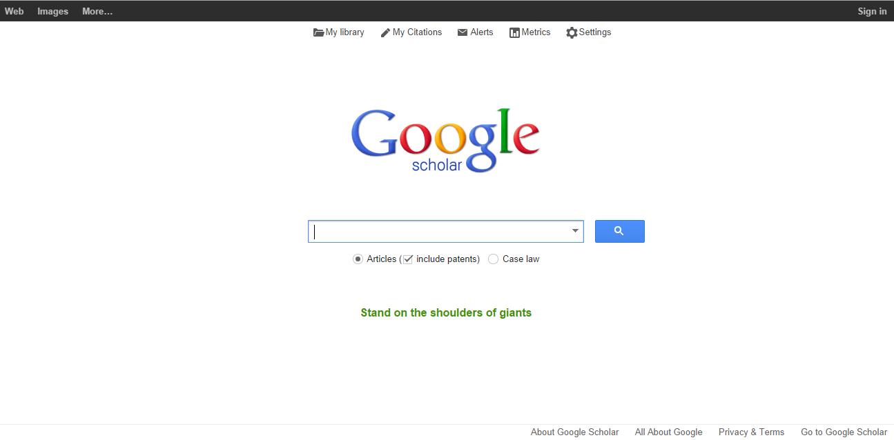
How to create Your Google Scholar Profile
scholar.google.com
Notes:
So, to get started, go to www.scholar.google.com

Slide 8
scholar.google.com
Notes:
Click the “My citations” button on the top right

Slide 9
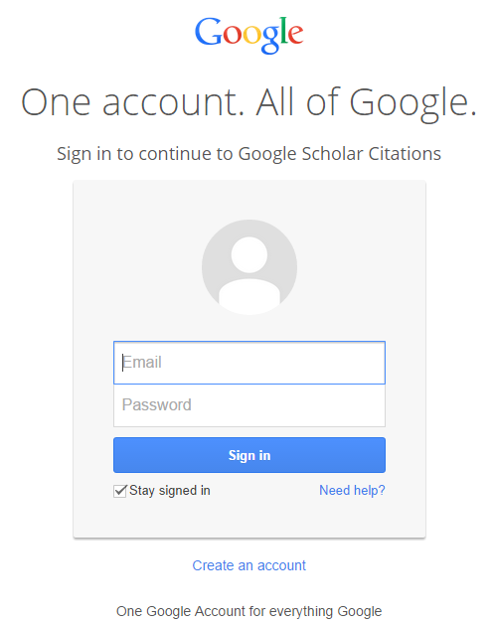
Log in using your Google account
Notes:
Log in using your Google account

Slide 10
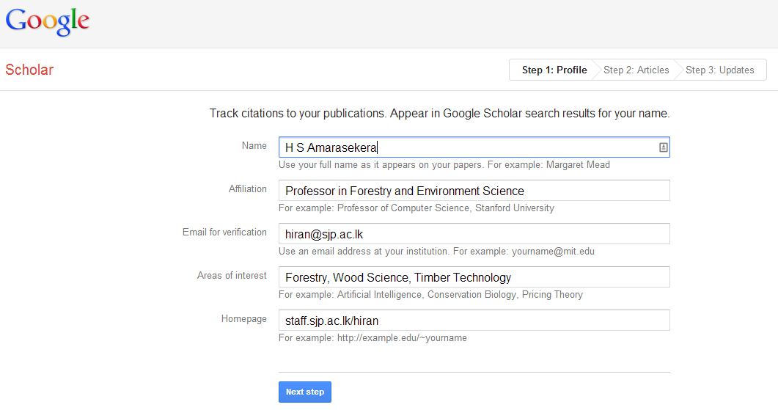
Complete the required fields and as much additional information as you are willing to provide
Note: a university ‘email for verification’ is required to appear in the search results!
Notes:
Step 1: Complete the required fields and as much additional information as you are willing to provide
(Note: a university ‘email for verification’ is required to appear in the search results!)

Slide 11
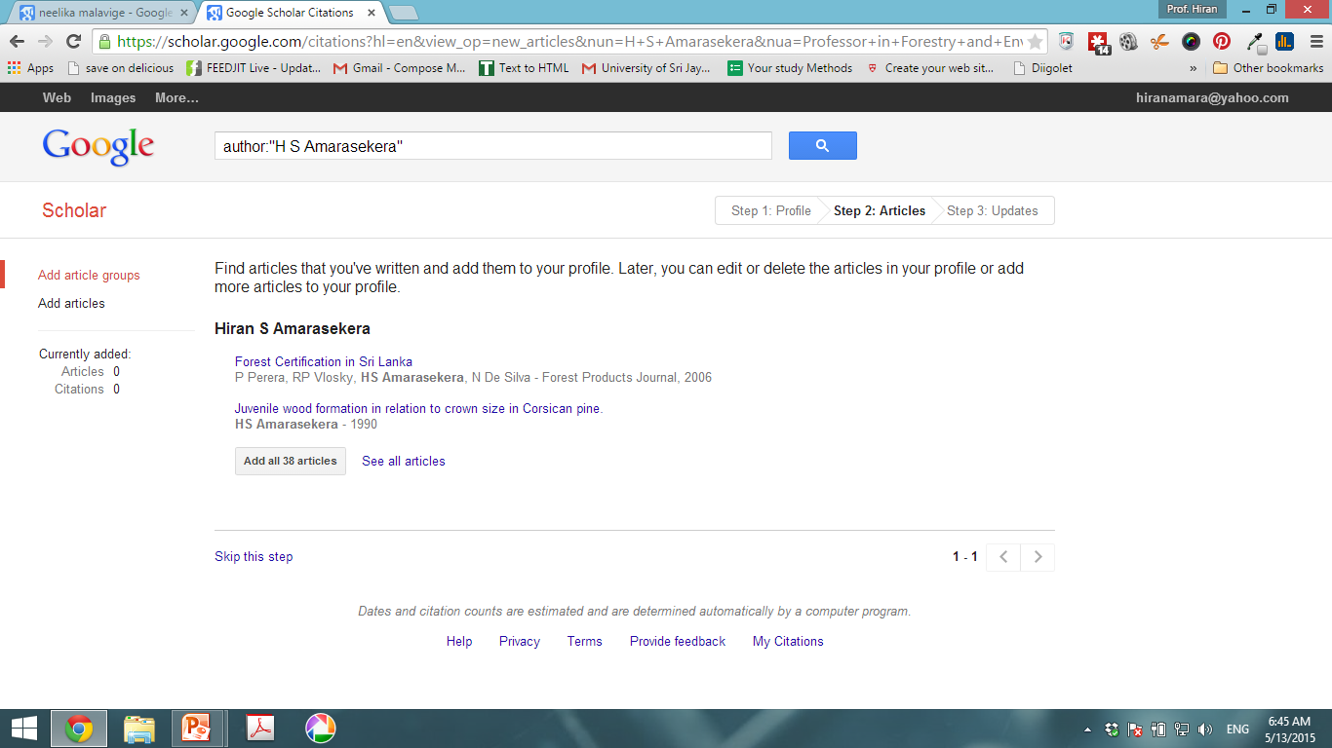
Select your articles, either by groups or individually
Notes:
Step 2: Google scholar will provide a list of articles it thinks you have authored/co-authored. Select your articles, either by groups or individually.

Slide 12
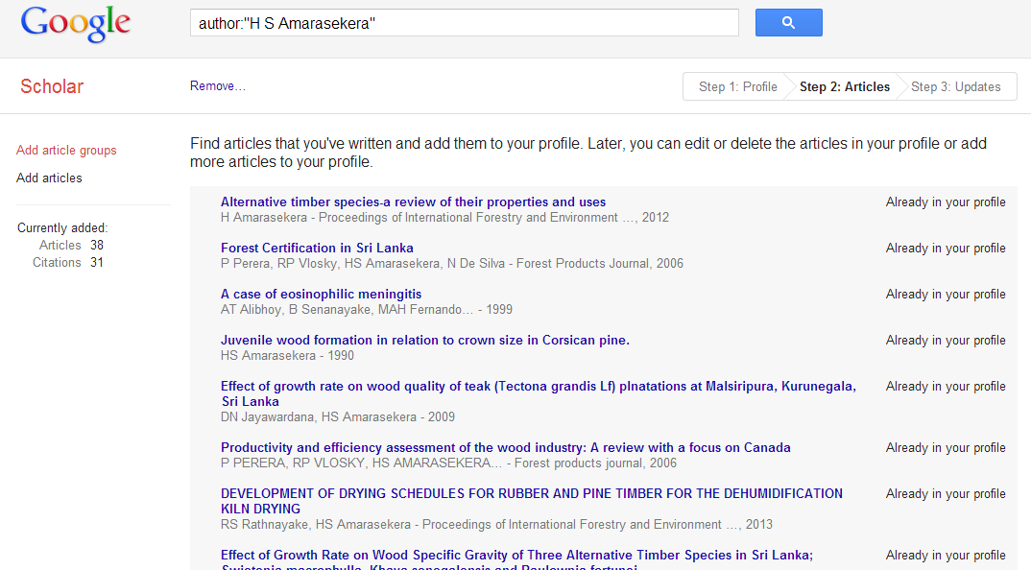
Your articles will appear. You can delete or add more articles to your profile later. Or you can remove Articles now.

Slide 13
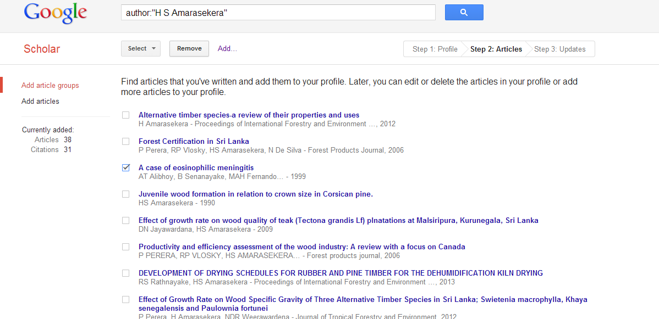
Remove Articles not written by you.

Slide 14
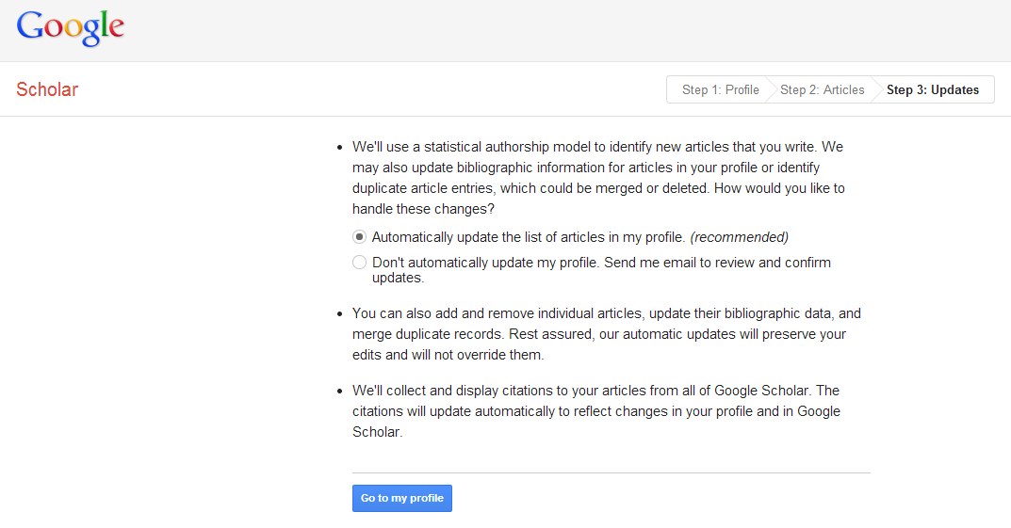

Slide 15
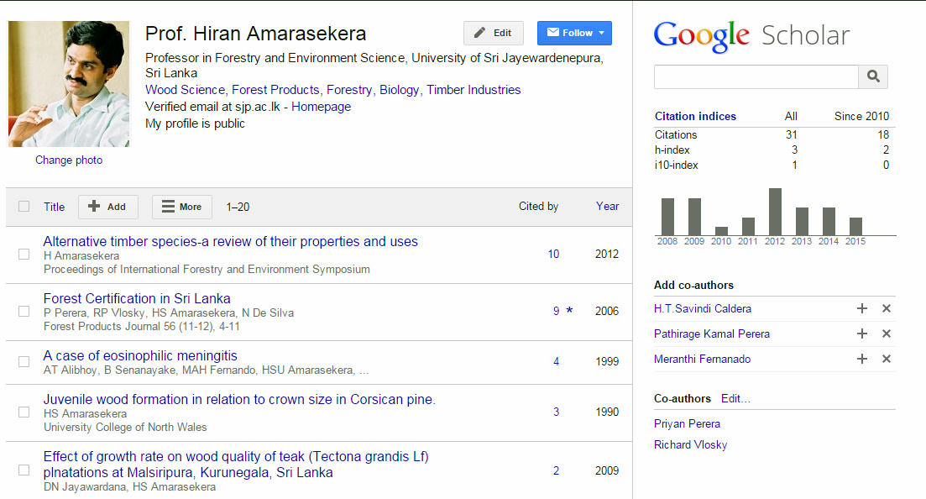
Notes:
Initially, your profile will be private. So you can take the time to add additional publications that Google didn’t suggest and build up a list of publications, if you would rather wait to make it public.

Slide 16
Notes:
Initially, your profile will be private. So you can take the time to add additional publications that Google didn’t suggest and build up a list of publications, if you would rather wait to make it public.

Slide 17
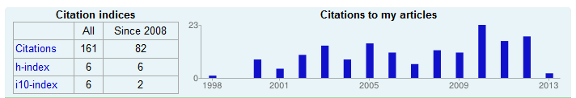
Metrics: Citation indices
Citations: how many times someone has cited your article
  All: over the whole of your career
  Since 2008: in the past 5 years (i.e. recent citations)
Notes:
The citation indices box shows you:
Citations: how many times someone has cited your article
All: over the whole of your career
Since 2008: in the past 5 years (i.e. recent citations)

Slide 18
Metrics: Citation indices
H index: the largest number h such that h publications have at least h citations
i.e. The H-index here is 6 as this academic has 6 papers with at least 6 citations
Notes:
H index: the largest number h such that h publications have at least h citations
i.e. The H-index here is 6 as this academic has 6 papers with at least 6 citations

Slide 19
Metrics: Citation indices
i10 index: the number of publications that have at least 10 citations
Notes:
H index: the largest number h such that h publications have at least h citations
i.e. The H-index here is 6 as this academic has 6 papers with at least 6 citations

Slide 20
h-index shows ….
researcher output (papers published) and
impact (citations received)

Slide 21
How is the h-index calculated?
The h-index of a researcher is the number n of the researcher’s published papers that have each been cited at least n times by other papers.
For example, if a researcher has published 23 papers of which 16 have been cited at least 16 times each, then his/her h-index is 16.
http://www.editage.com/insights/how-citation-metrics-can-help-you-benchmark-your-research-impact

Slide 22
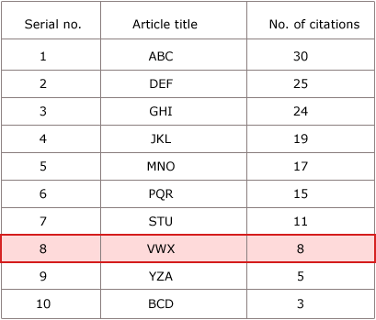
How is the h-index calculated?
Arrange all papers in decreasing order of citations per paper
H-index = highest serial no whose value is less than or equal to no of citations
Here, 8 is the highest point at which the serial number remains less than or equal to the number of citations.

Slide 23
Problems with h-index
Cannot be used to compare scientists across disciplines –
  Eg- h-indices in the biomedical fields are higher than many physical sciences, because more people working in these areas
It also counts self-citations
It disregards highly cited papers
  a researcher with a few high-impact papers may have a similar h-index to one with many low-impact papers.

Slide 24
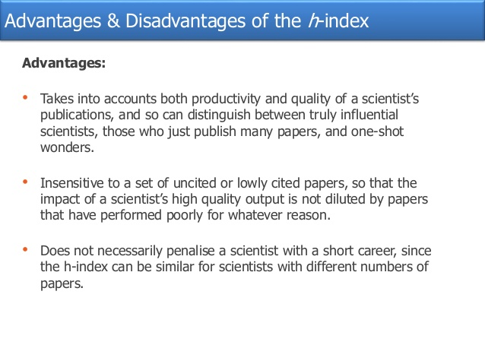

Slide 25
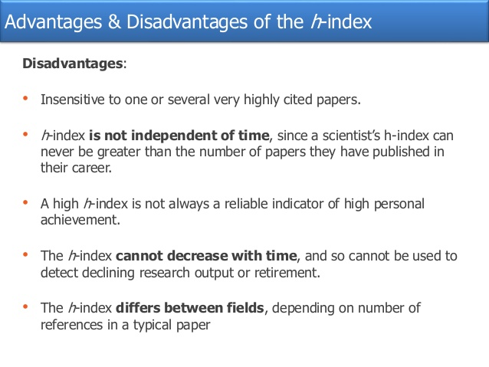

Slide 26
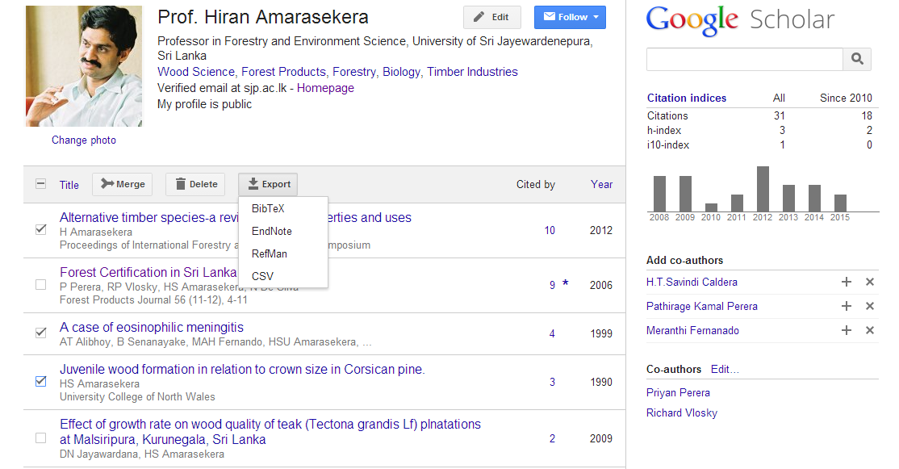
Select articles to see merge, delete, and export buttons

Slide 27
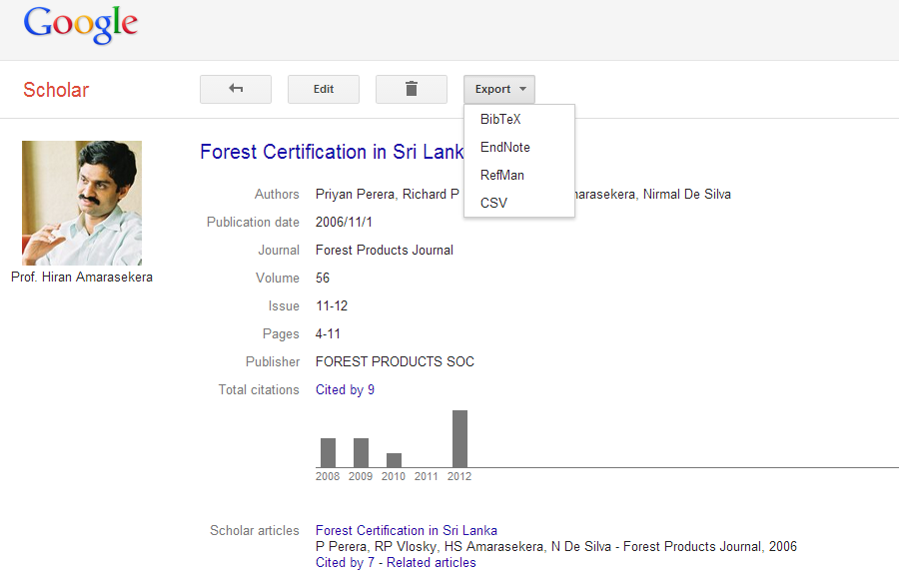

Slide 28
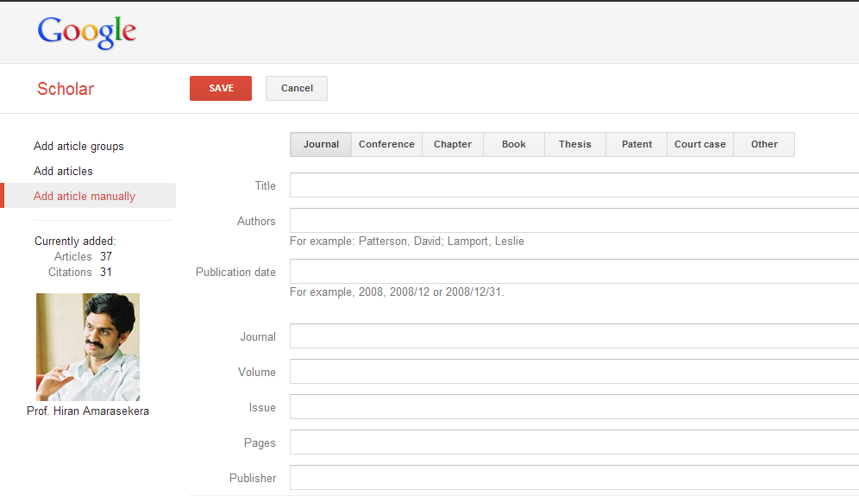
Adding an article manually
Notes:
To add an article manually from “add articles”, click “add article manually”

Slide 29
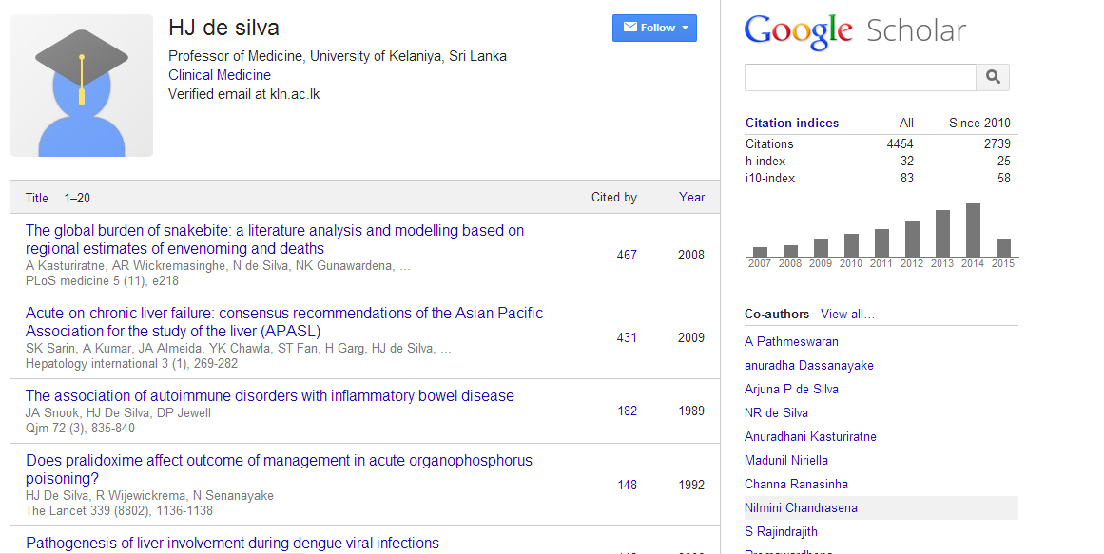
2nd Highest rank in Sri Lanka

Slide 30
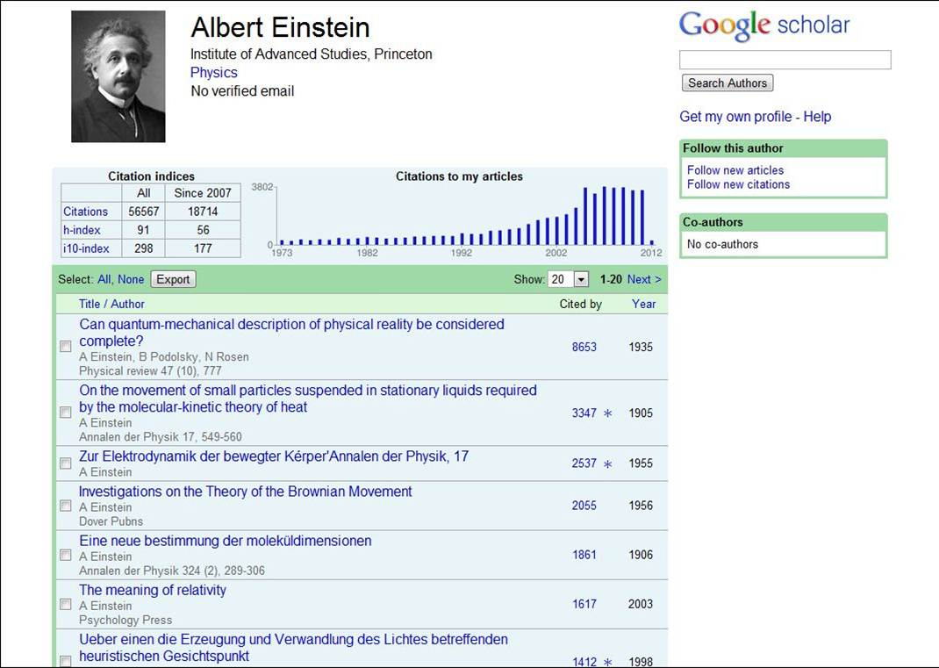

Slide 31


Prof. Hiran amarasekera
University of Sri Jayewardenepura
Address
Department of Forestry and Environment Science
University of Sri Jayewardenepura
Nugegoda
Sri Lanka
Japura Media
  Website: http://staffweb.sjp.ac.lk/?q=hiran/
Email: hiran@sjp.ac.lk
Phone
  011 2804685
Evaluating wood products | 24/03/2015

